Slide 1
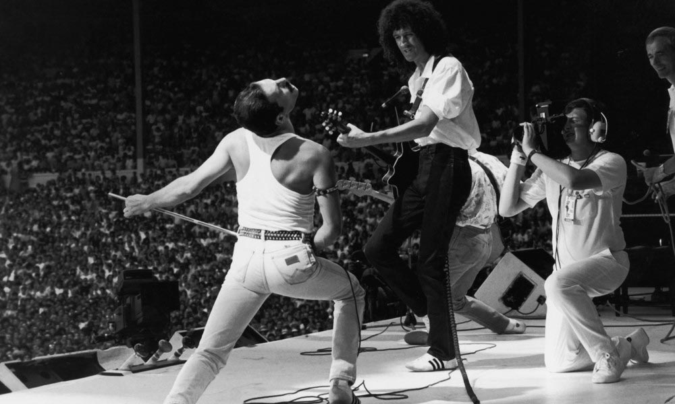
Billboard Hot 100
Is the movement of the songs over time predictable? Can we predict a movement of an individual song?

Slide 2

What is the Billboard Hot 100?
Started in 1958, the Billboard Hot 100 keep a weekly chart of the 100 most successful singles in the USA as of each week
They also keep data for whether the song went up or down, and it’s overall highest position
The parameters they use to decide a songs placement have always been a mystery, and have changed throughout the years due to changes in the music market

Slide 3
Data Source for crawling:
The official Billboard website:
https://www.billboard.com/charts/hot-100/

Slide 4
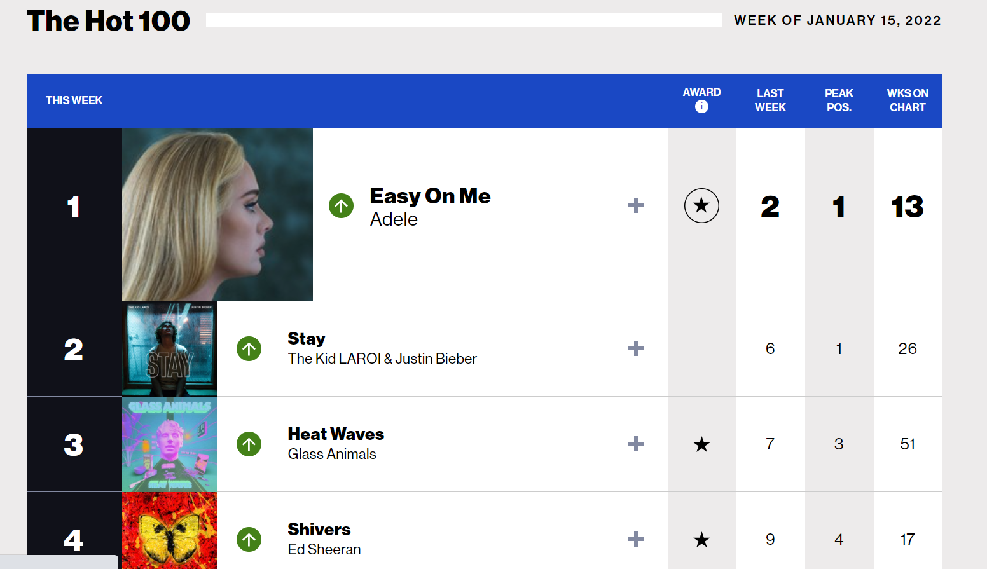
Crawling and Scraping the Billboard Website
Scraping - Used BeautifulSoup to identify the song table and each individual song in it, and put the song name, artist name, current position, max position, weeks on chart and relative movement in a database
Crawling – I noticed that you can access different weeks by simply adding a date to the URL, so after identifying it’s format I wrote a simple loop that goes through N pages by starting at the latest week and going back a week each time

Slide 5
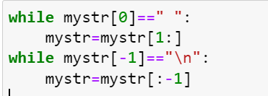
Data cleaning
There weren’t really any Nan columns, so this step was relatively short. However, I did need to fix a few artist\song names due to accidental spaces or \n in the end of names.
Luckily there were no Nan values to be found, so those didn’t need cleaning

Slide 6
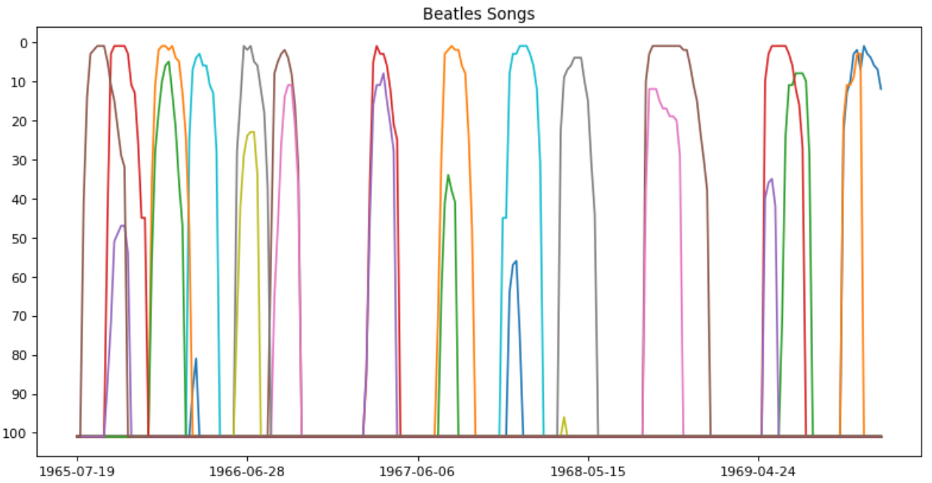
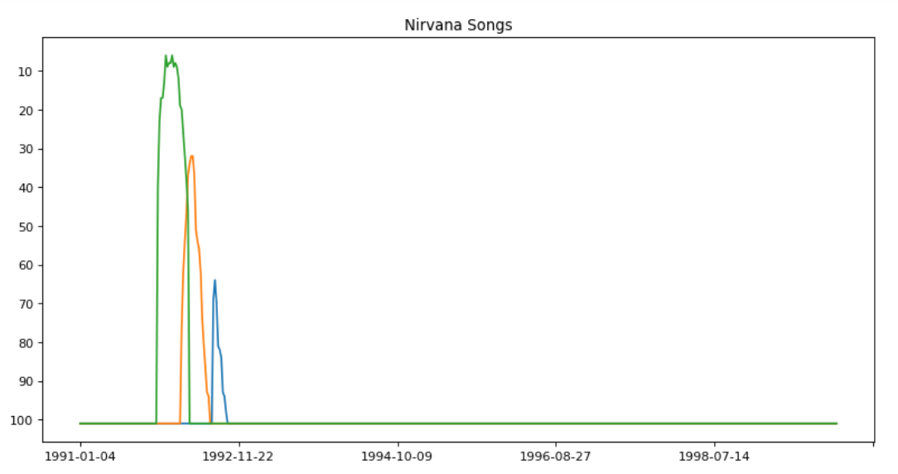
EDA – Song Life Span
I found that songs typically live through a standard span of going up, staying fairly steady and then going down. We can assume than that a song that has gone down for 2+ weeks is unlikely to go back up
As you can see, all songs have a roughly simillair shape regardless of peak position

Slide 7
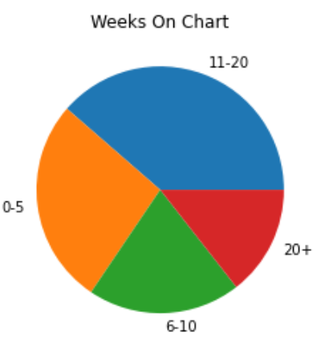
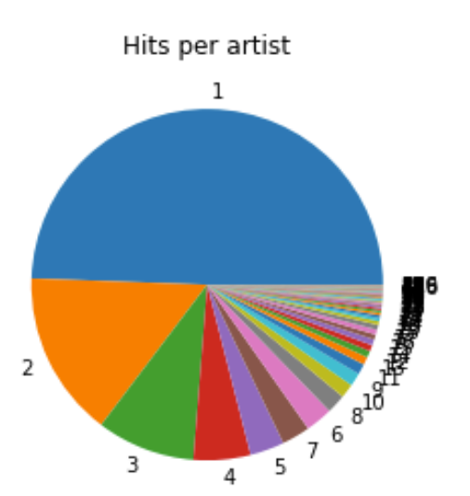
EDA – Additional Visualizations
While the plurality of songs are middle-ranged hits (11-20 weeks on the chart), it appears that if you group them to smalltime (>10 weeks) and bigtime (<10 weeks) you get an almost 50-50 split
Additionally, you can see that half of the artist on the chart are one hit wonder artists, but considering the 258385 songs overall, 3109 one hit wonders isn’t actually that big a part of them.

Slide 8
Machine Learning - KNN
I had decided to go for KNN because all relevant fields it is a categorization problem – choosing whether a song will go up,down or stay the same.
The algoritham started at around 60% accuracy (with an older version of the dataset that I have since lost in iterations), but as of the end it got 71.8% accuracy

Slide 9
What’s hurting the accuracy?
The fluctuations of songs is just very volatile!
The algorithm can’t predict the release of new songs, real life scandals, and all real world things that effect a song.
And most of all – I can’t seem to make it that much better! I tried removing abnormal songs from the list, I.E ones that appeared for more than 2 years or that only appear each Christmas, but it seems like it dosen’t really help
Also tried adding columns, like wether a song has gone down twice in a row or number of artist hits up until the song release, and nothing helps.

Slide 10

Conclusion
While it was an interesting experience, sadly I feel that this is a much more complex question than just one of raw numbers
Still, 71.8 % isn’t the worst and there are still valuable insights to be learned for an improved version of the algorithm
And graphs do tell you interesting, valuable and enjoyable information, such as the wrath of “All I want for Christmas is you” coming every year

